Slide 1

CSE- 4105
Lecture- 10
Projection-II

Slide 2
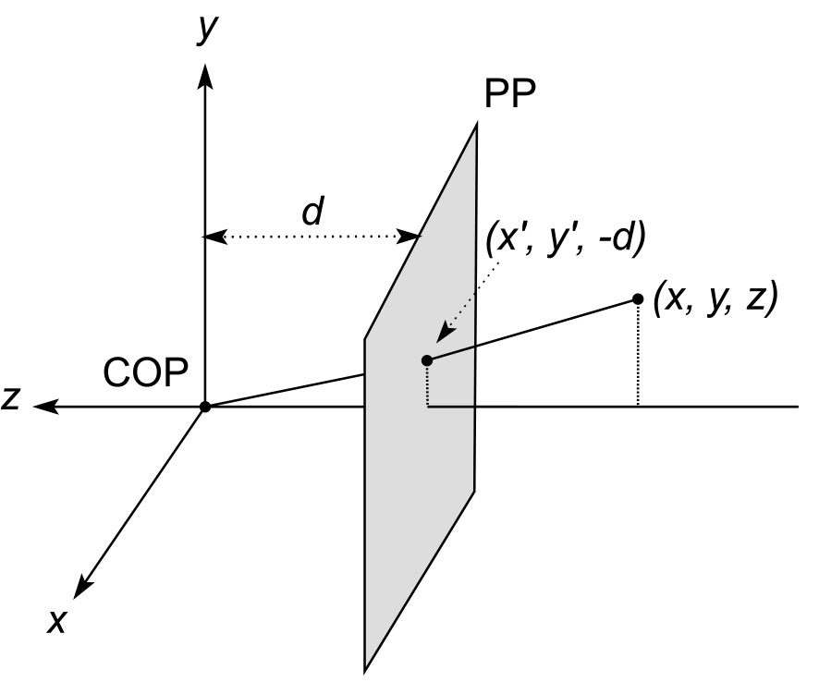
Derivation of perspective projection
Assume projection plane is normal to z-axis.
Projection point is at origin and projection plane is at distant d.

Slide 3
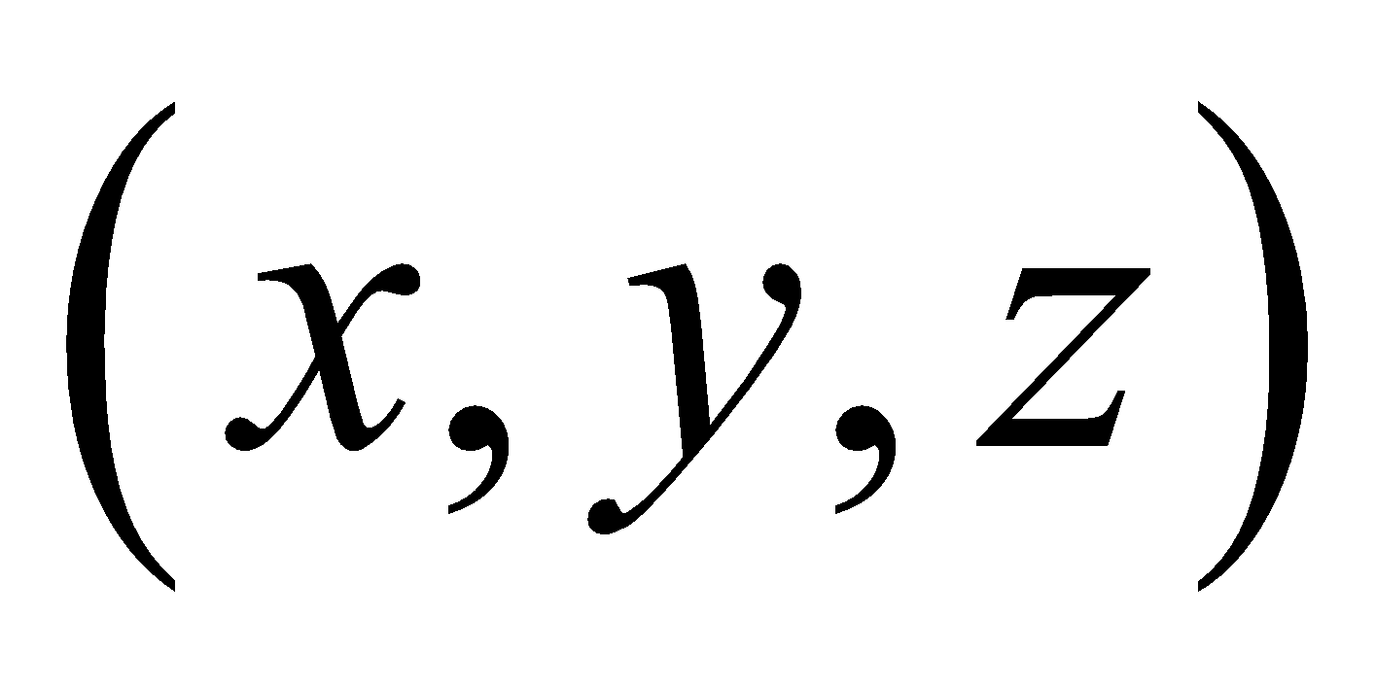
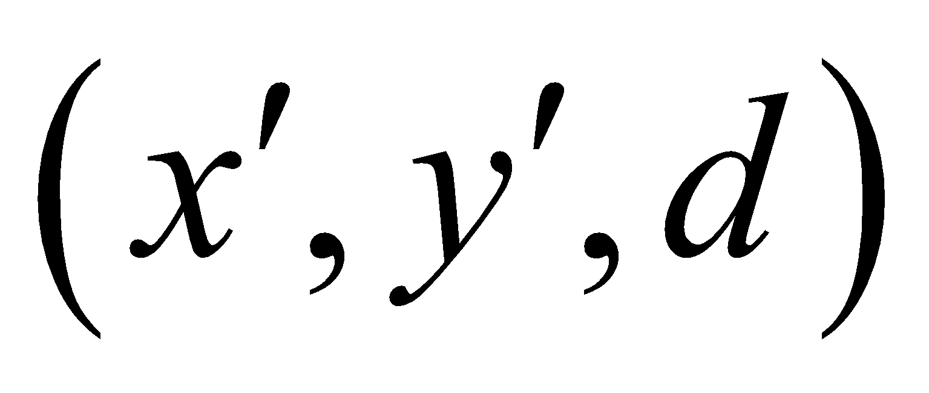
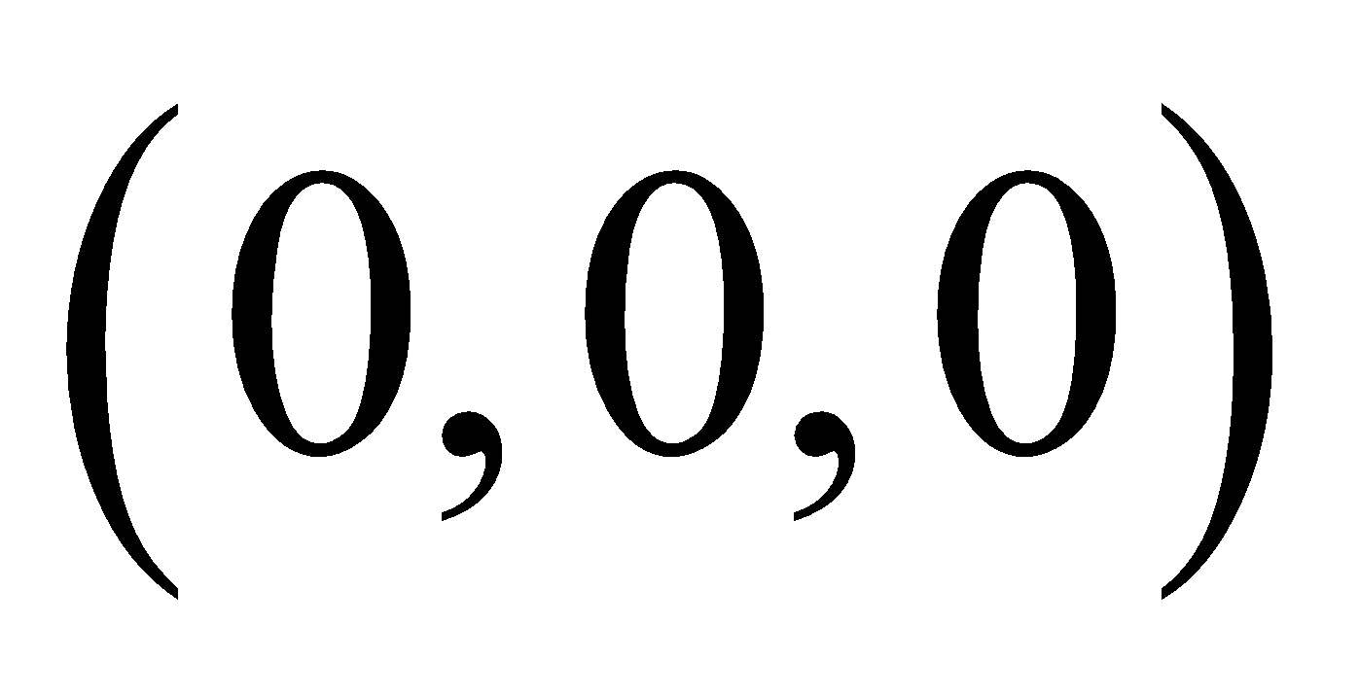

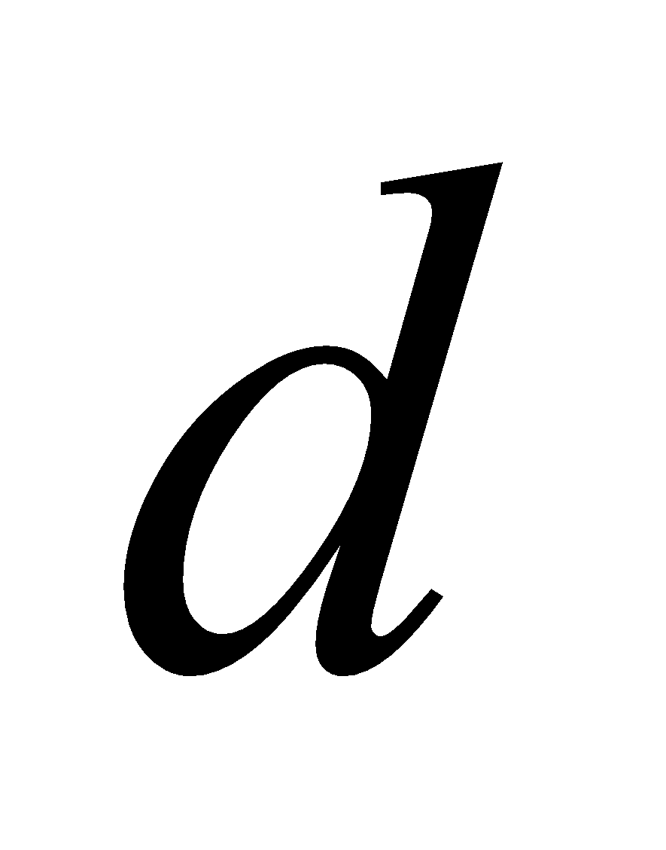



Derivation of perspective projection
Now we see two triangle namely ΔABC and ΔADE
Projection point is at origin and projection plane is at distant d.
D
Apply similarity rule:
B
A
C
E

Slide 4




Derivation of perspective projection
Similarly
D
B
A
C
E

Slide 5
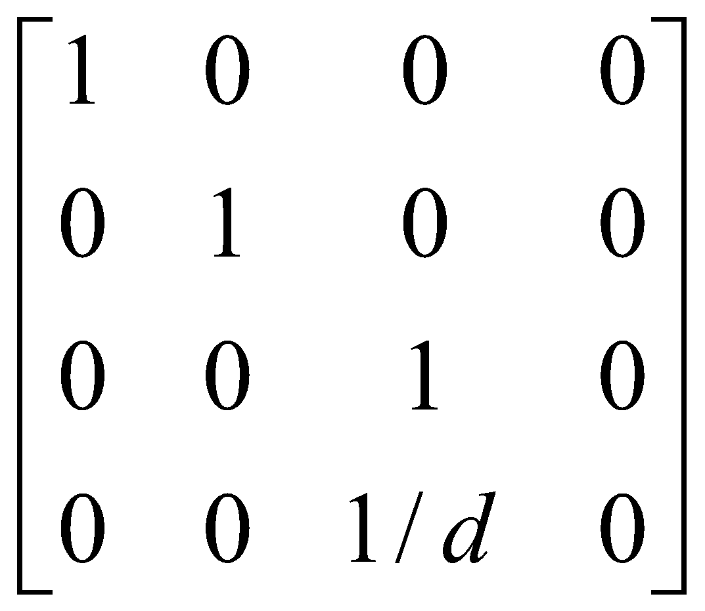
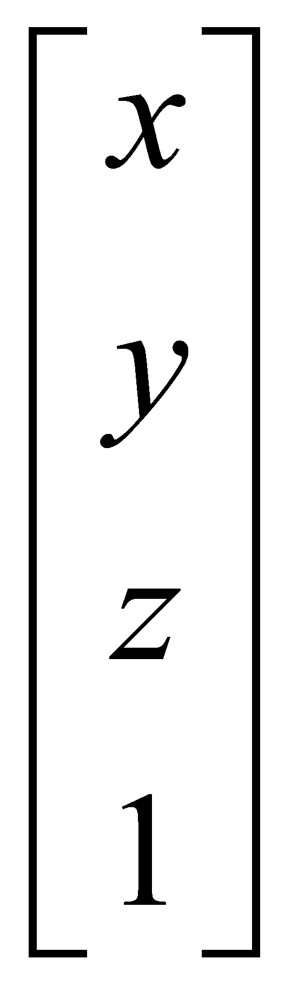
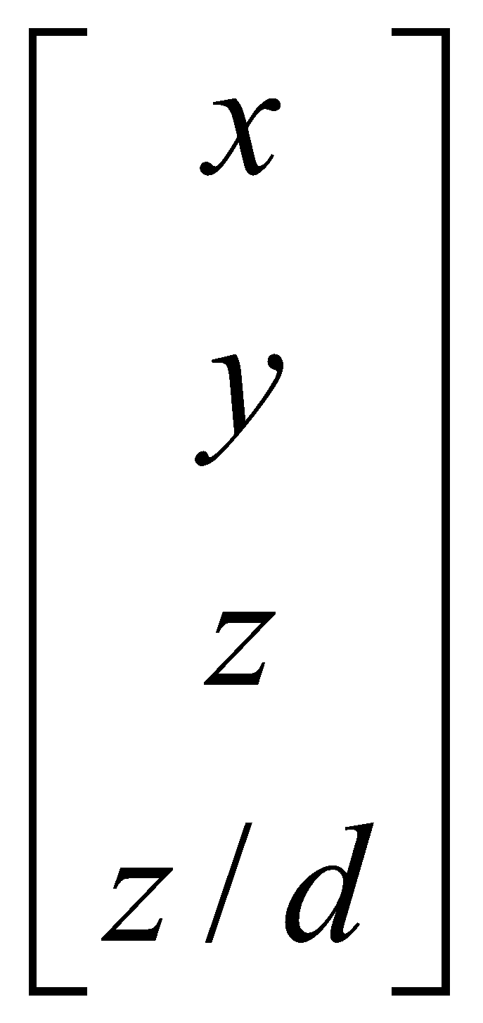
Homogeneous Coordinate Form
The transformation can be represented as
If we multiply the homogeneous point P=(x,y,z,1) by M, to get the projected point P’ we obtain:
M =
P’ =MP=
=

Slide 6



Derivation of perspective projection
If the projection plane is placed at z=0.
Apply similarity rule:
D
B
A
C
E
d

Slide 7
Derivation of perspective projection
If the projection plane is placed at z=0.
Apply similarity rule:
D
B
A
C
E
d

Slide 8


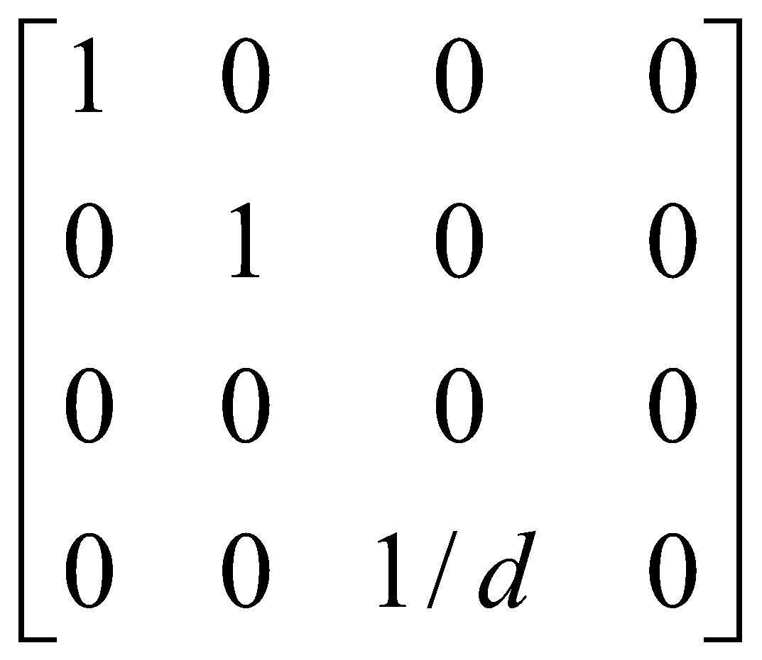
Derivation of perspective projection
If the projection plane is placed at z=0.
Similarly
D
B
A
C
E
d
M’ =

Slide 9
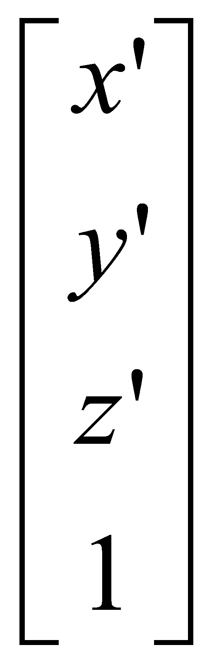
Derivation of perspective projection
We get
=

Slide 10
Thank You

